Slide 1

VECTORIZE YOUR CODE advanced s l
Super Python Talks, 19.VII.2017
Andreas Kist

Slide 2

http://insights.dice.com/2014/03/05/data-science-is-dead/

Slide 3
Lists
Python in-built.
Very convenient (list comprehensions)
Can carry everything
Flexible length
Disadvantages:
Iterate via for loops -> SLOW.
Nested operations complicated
In-place operations no real speed advantage.

Slide 4
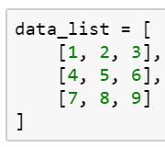
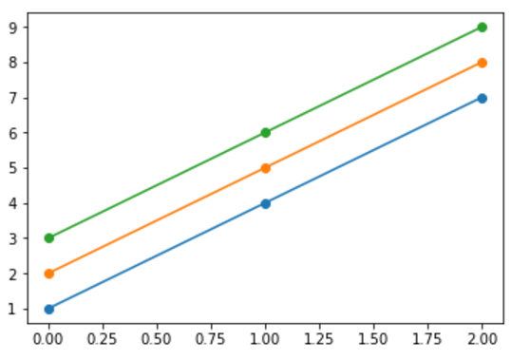
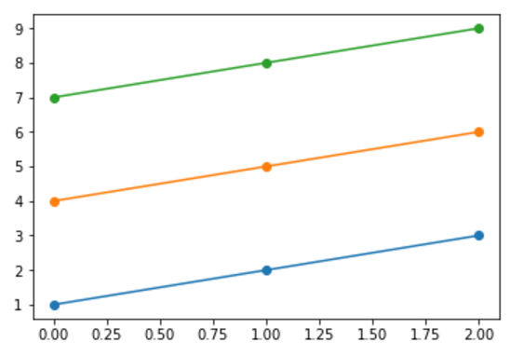

Example: Plot lists
This is not what we want, we would like this:

Slide 5


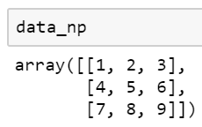
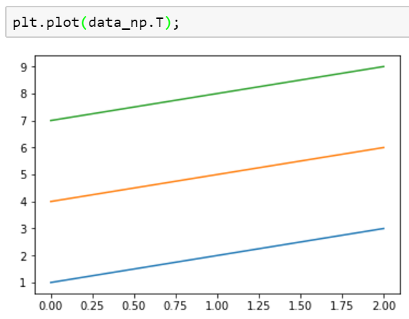


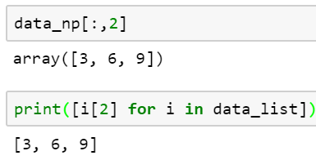
Numpy – „lists“ with benefits
Numpy has arrays, not lists.

Slide 6
Numpy.
Advantages
Can handle N-dimensional arrays
Intel MKL support
Memory efficient
Fast in-place methods
Similar to MATLAB syntax (differences)

Slide 7
Circumvent disadvantages
Nested lists can be of abritrary length, numpy arrays not.
=> Solution: interpolation.
np.interp(x, xp, fp)
Example:
np.interp(new_time, old_time, data)

Slide 8
Do easily the most common tasks
Std
Mean
Sum
Cumsum
Min
Max
And, most important, along any axis or axes!

Slide 9
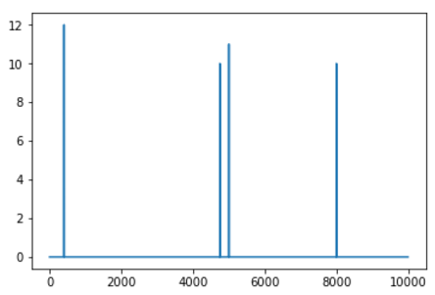
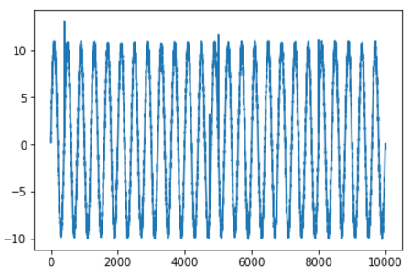
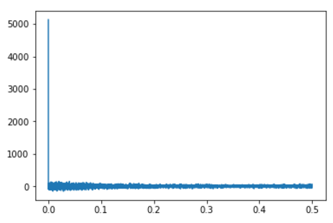
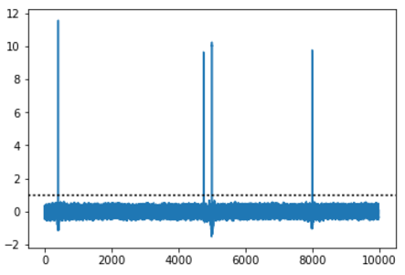
Powerful tool: Fourier transformations
Embedded using the FFT algorithm
Get rid of this spike
Input data
+ NOISE
Power spectrum
Cleaned data

Slide 10
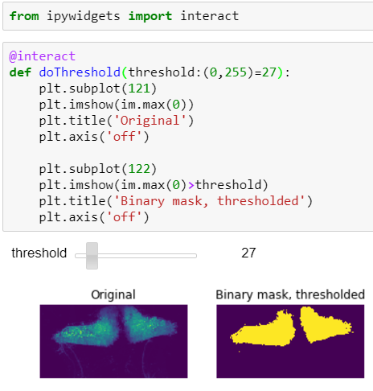
Using numpy for thresholding

Slide 11
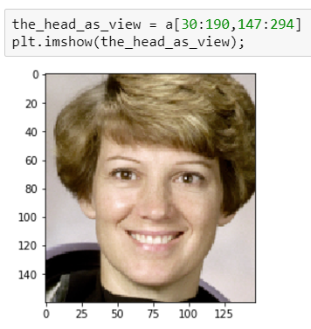


Work with views
Intended: Good, it is automatically a view!
Not intended: Use a deep copy: a[10:100, 20:200].copy()

Slide 12
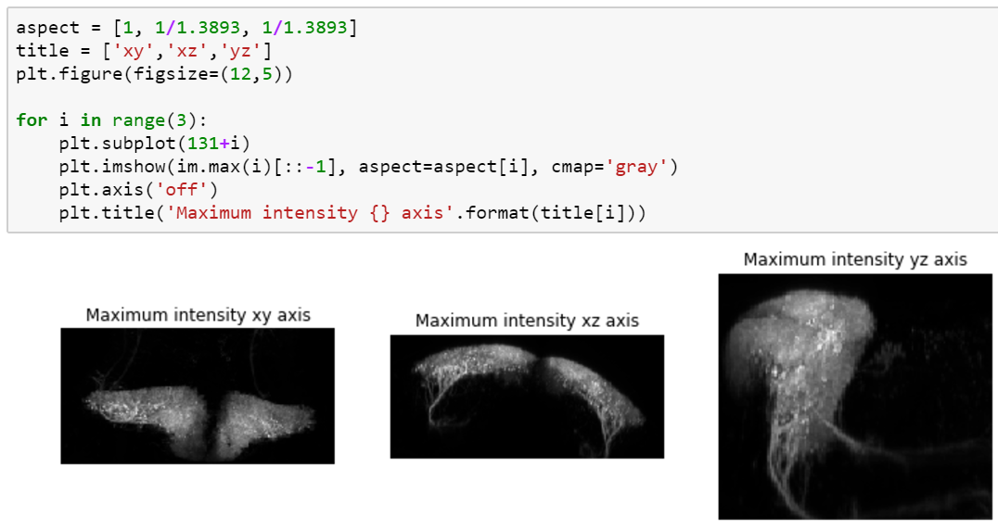
Fast image processing
Maximum intensity projection of all 3 views!

Slide 13
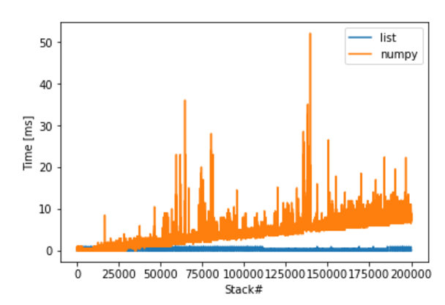
Advantage lists vs. Numpy arrays
Stacking of unknown number of values (e.g. data acquisition)

